Slide 1

File display, redirections and pipes
Starting to feel the force of Linux
1
File display, redirections and pipes

Slide 2

Overview
Operations
Directories
Common to both
Files
Create
mkdir
Remove
rmdir
Remove
rm
Display
(e.g., cat)
Copy
cp
Create
(e.g., touch)
Move/rename
mv
Edit
Find
find
Print
Link
ln
Other
2
File display, redirections and pipes

Slide 3
Overview
Files
Display
Create
Edit
Print
Other
lpr
lpq
enscript
cat
touch
more
Compress contents
Count
words
less
Combine contents
pg
Editors (vim,
emacs, nano, …)
Encrypt/
decrypt
Extract contents
head
Unique lines
Redirections
sort
tail
Compare (diff)
3
File display, redirections and pipes

Slide 4


Generating text
We’ve spent several lectures creating files that had nothing in them. Now that we want to look and change the content of the file, we’ll need to create them with actual content.
Approach 2
Approach 1
4
File display, redirections and pipes

Slide 5
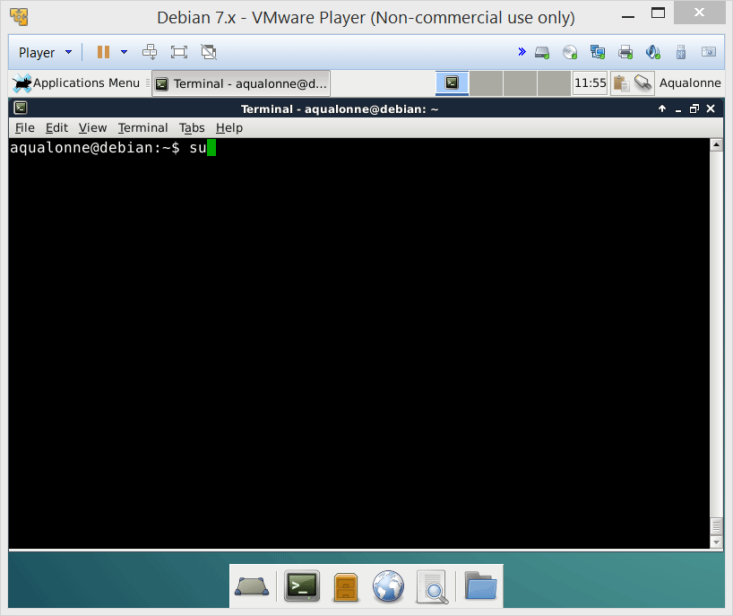
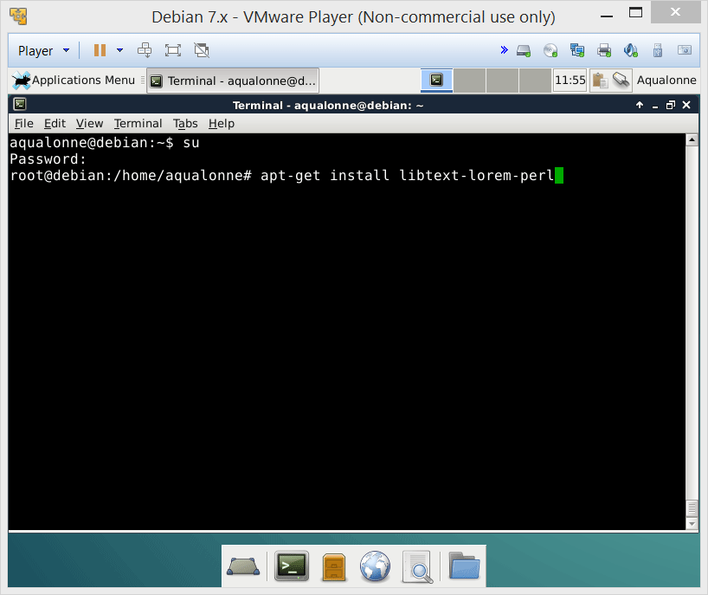
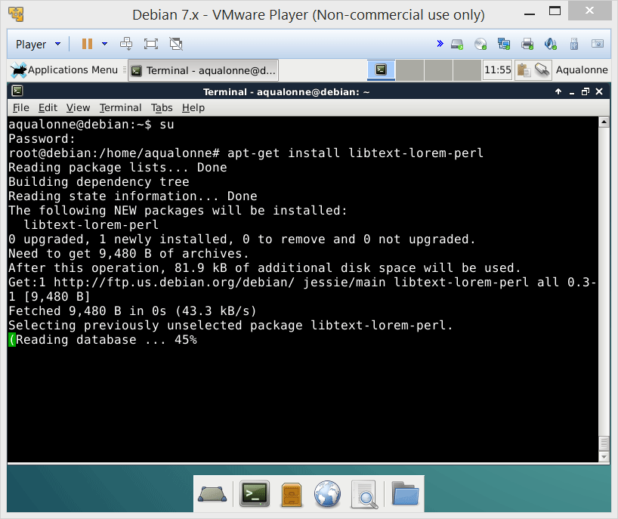
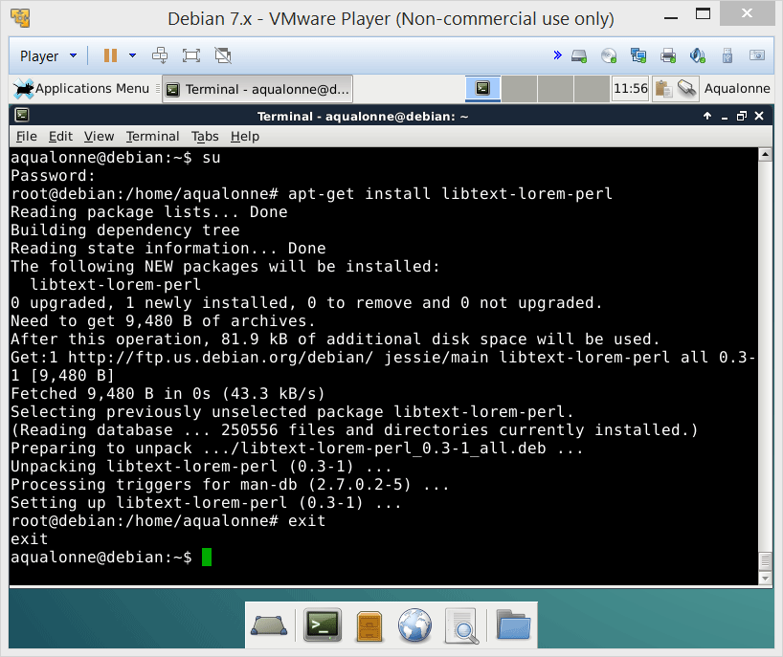
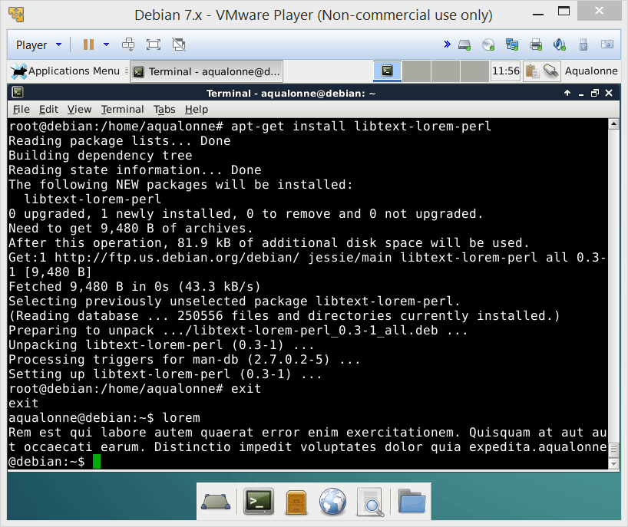
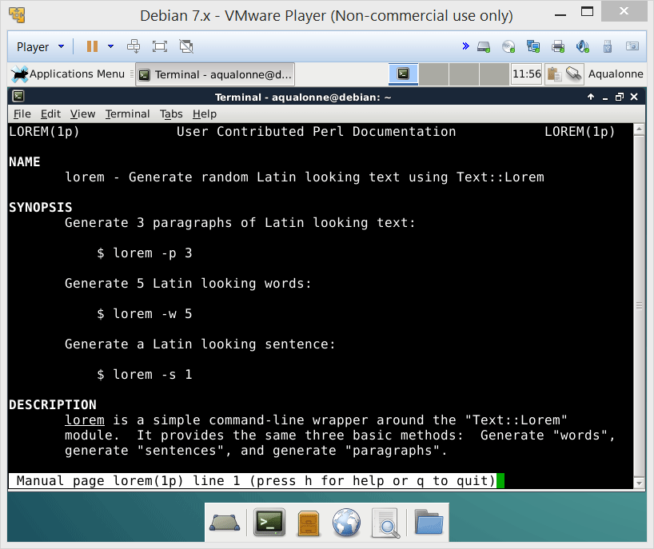
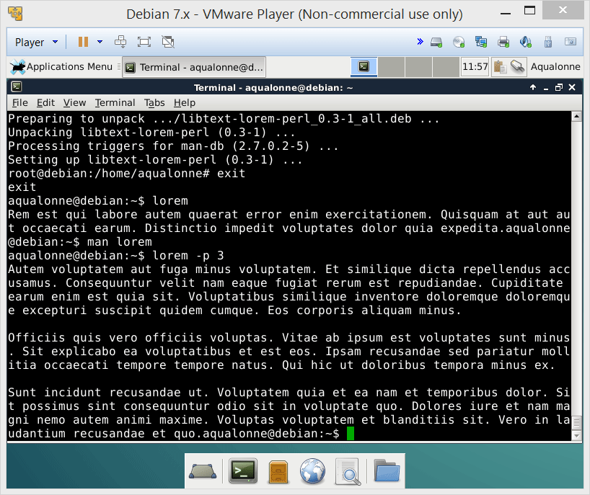
Generating text
Make sure to install lorem at home!
5
File display, redirections and pipes

Slide 6
Overview
Files
Display
Create
Edit
Print
Other
cat
touch
more
less
pg
head
Redirections
tail
6
File display, redirections and pipes

Slide 7

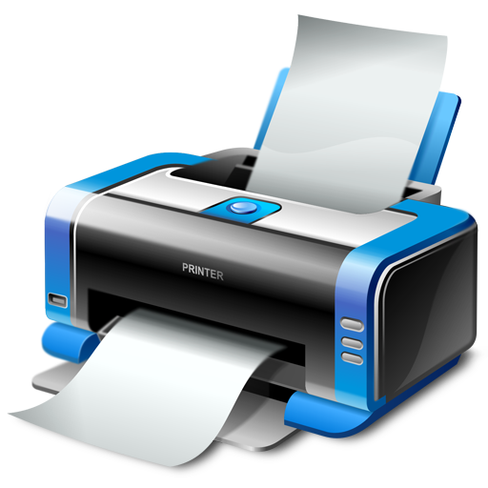

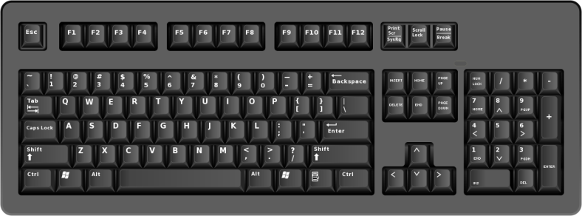
Redirection
Program
Standard error
Standard output
Standard input
The standard output normally goes to the screen, i.e. it is directed to the screen. We instead want to make it go to a file, so we say that we redirect it toward a file.
7
File display, redirections and pipes

Slide 8

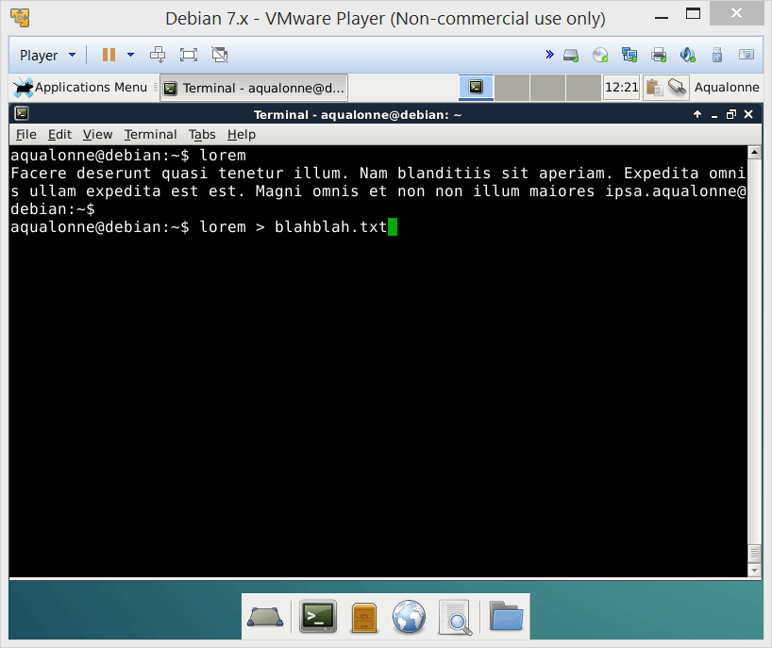
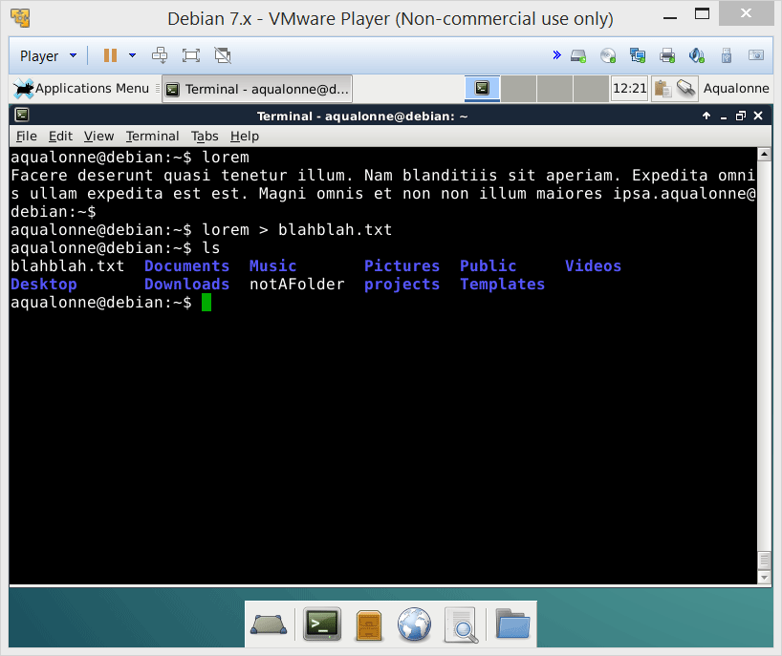
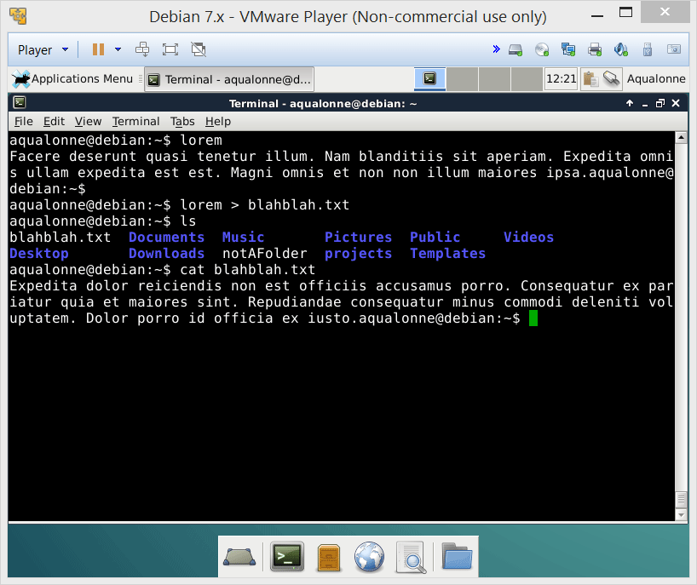
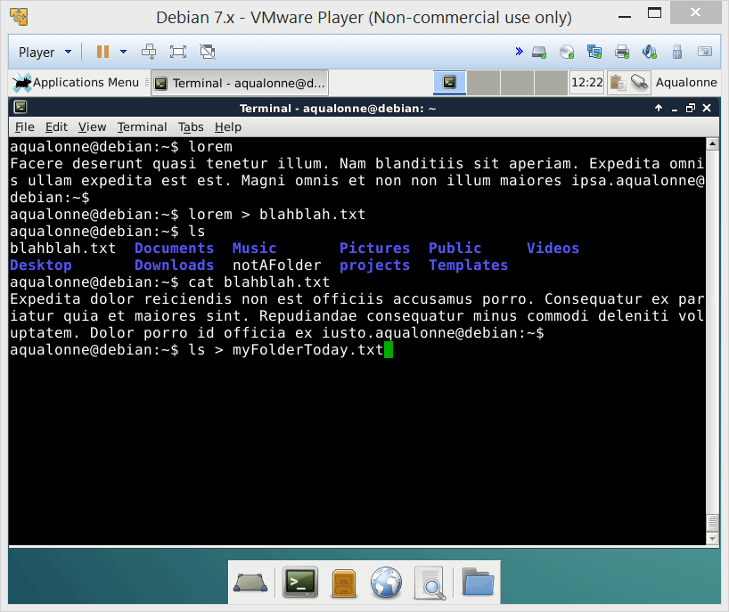
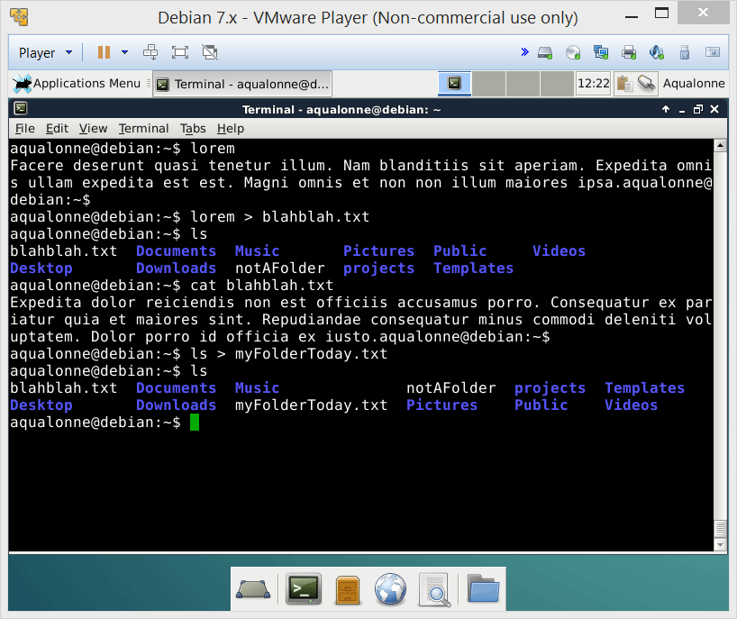
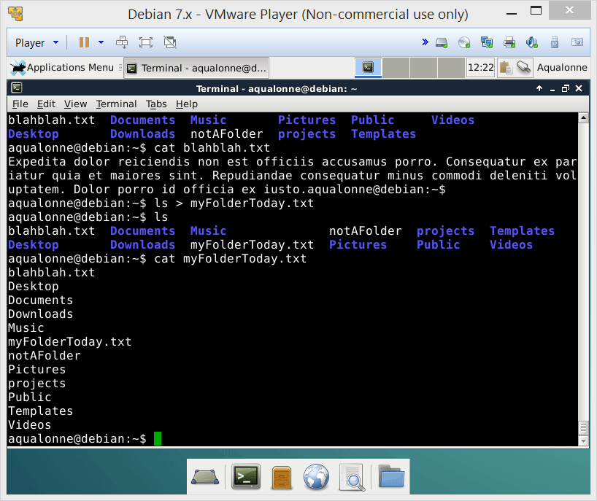
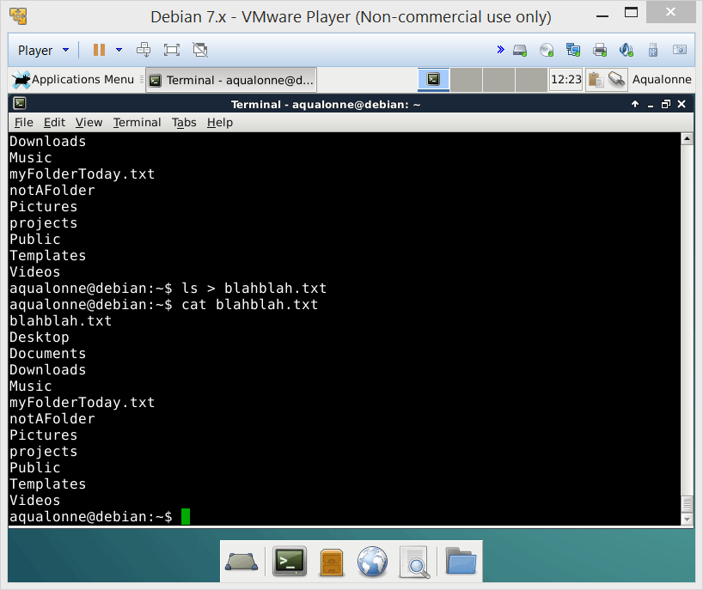
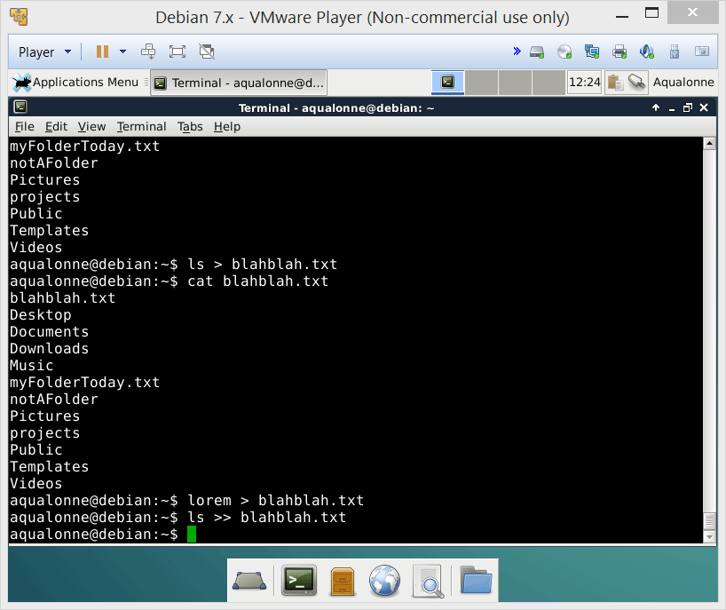
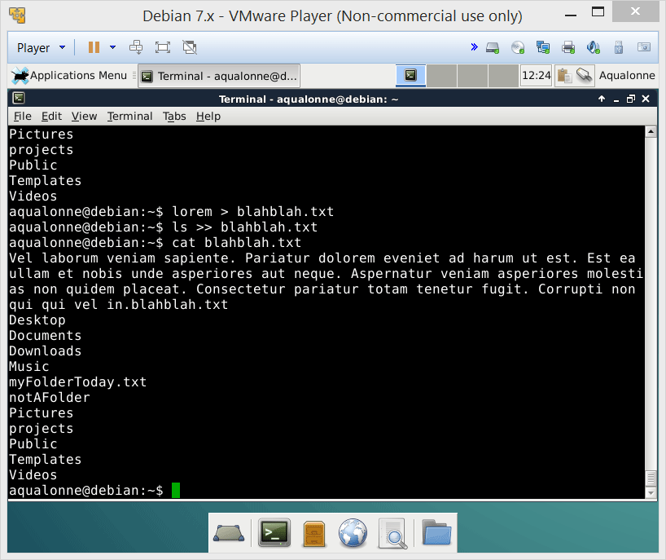
Redirection
8
File display, redirections and pipes

Slide 9
Redirection
To redirect the standard output, you can use either:
Command Syntax | Meaning
command > file | Redirect output from command to file Replaces the file if it already exists.
command >> file | Redirect output of command to file Appends if the file already exists.
To redirect the standard input, use:
Command Syntax | Meaning
command < file | Redirect input from file to command.
9
File display, redirections and pipes

Slide 10
Redirection
2> to create/replace
2>> to create/append
Program
Standard error
I/O 2
Standard output
Standard input
< to redirect
> to create/replace
>> to create/append
I/O 0
I/O 1
10
File display, redirections and pipes

Slide 11
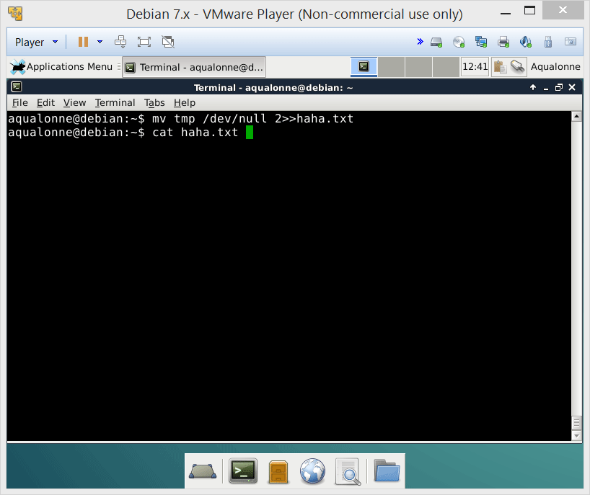
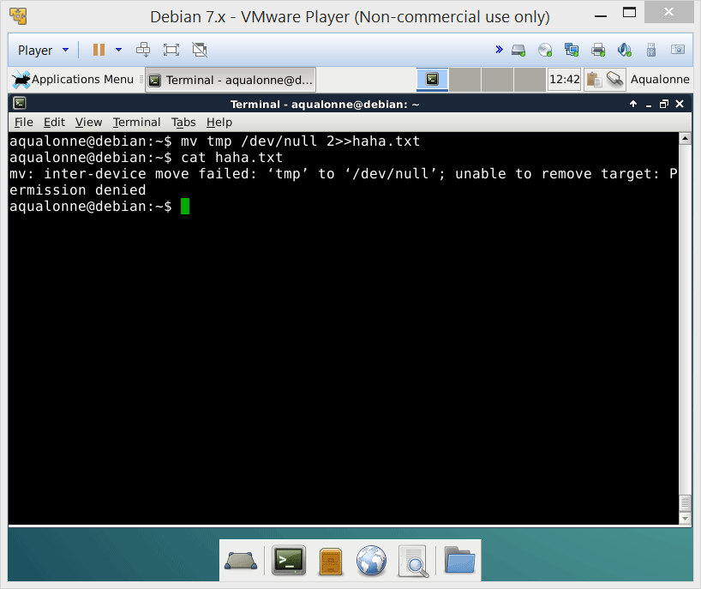
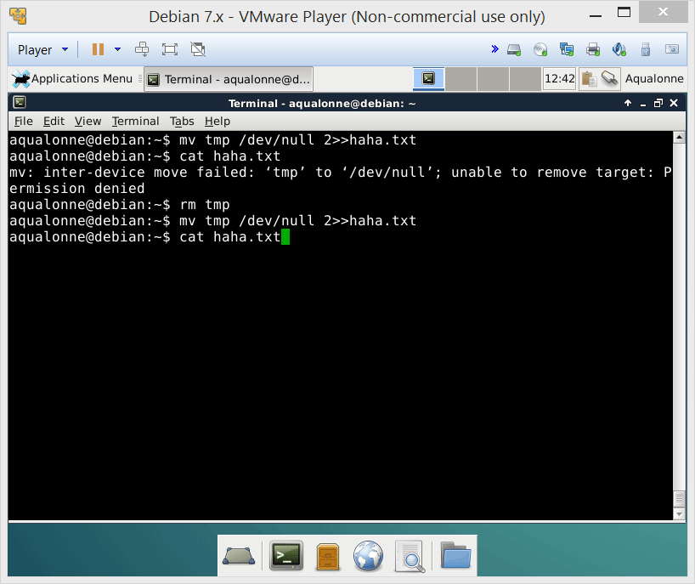
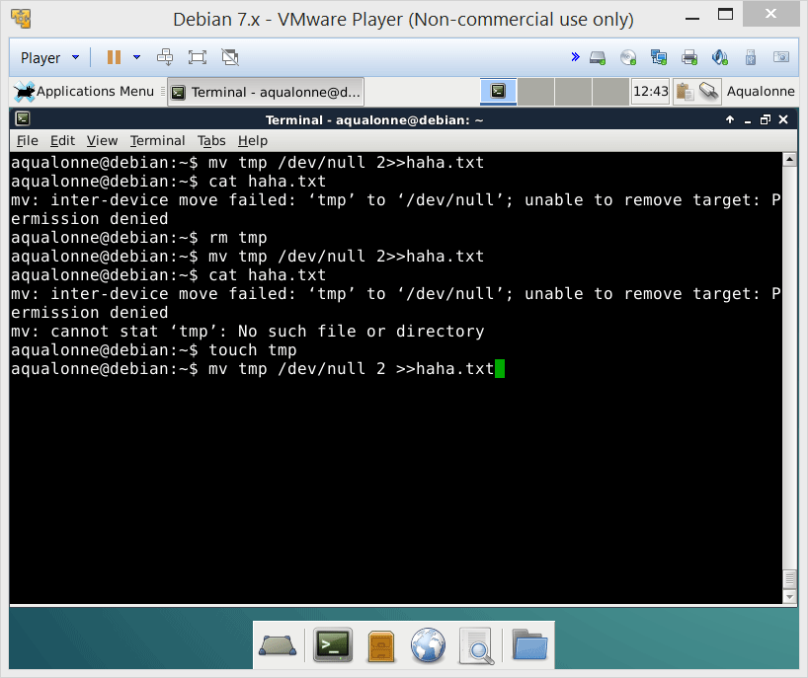
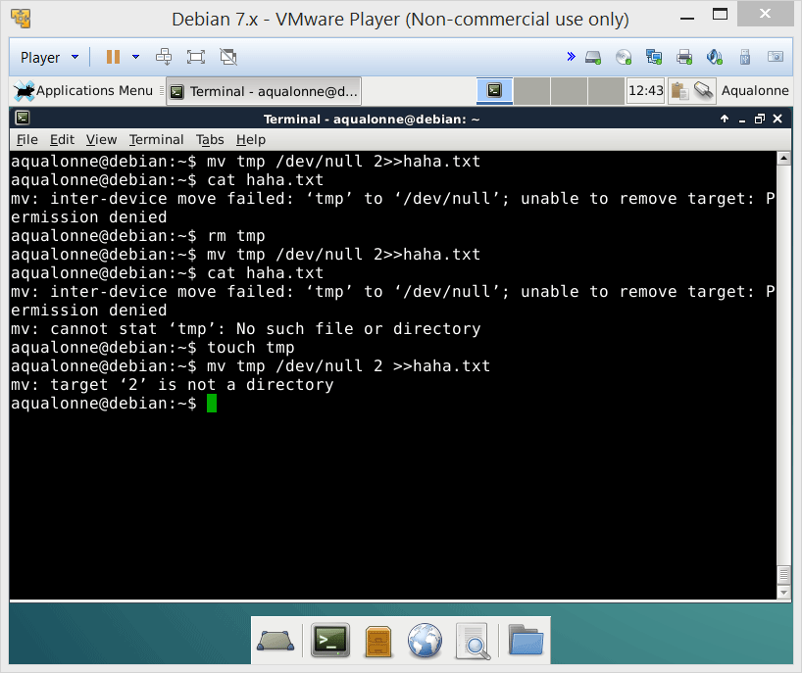
Redirection
11
File display, redirections and pipes

Slide 12
Overview
Files
Display
Create
Edit
Print
Other
cat
touch
more
less
pg
head
Redirections
tail
12
File display, redirections and pipes

Slide 13
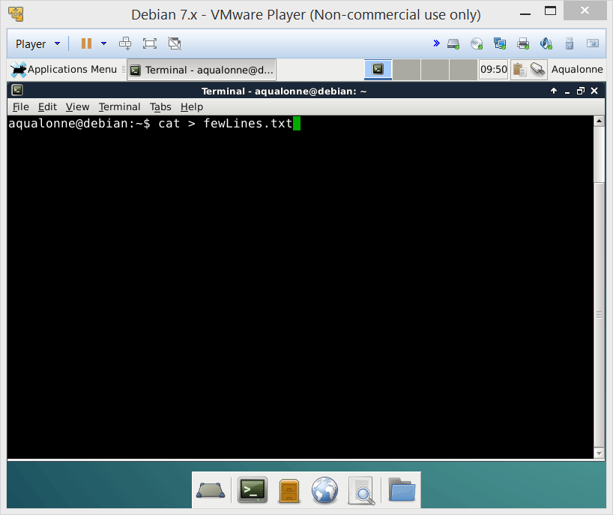
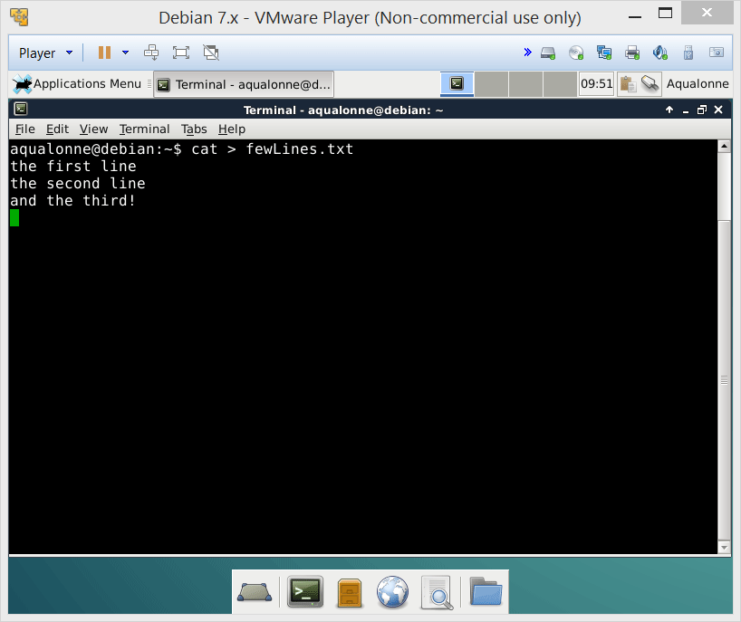
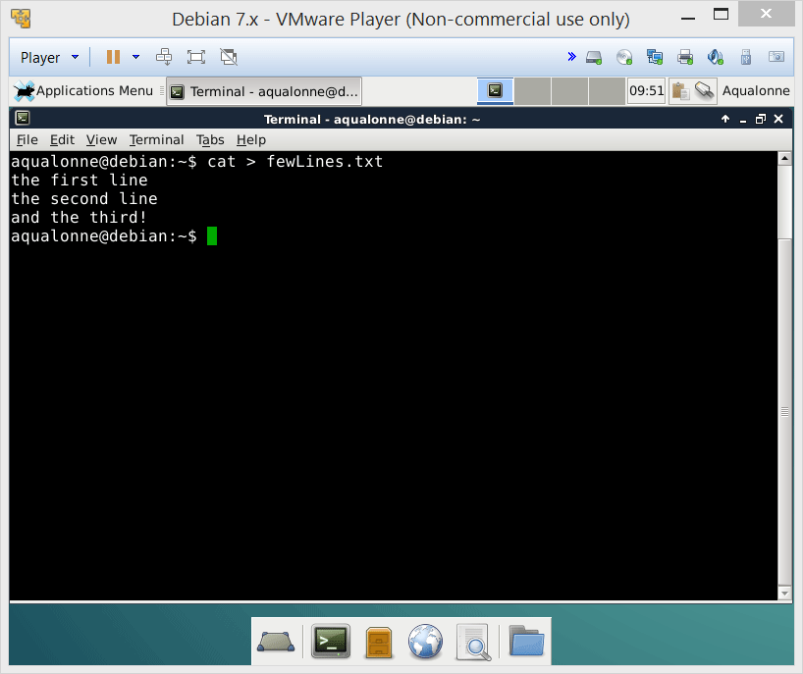
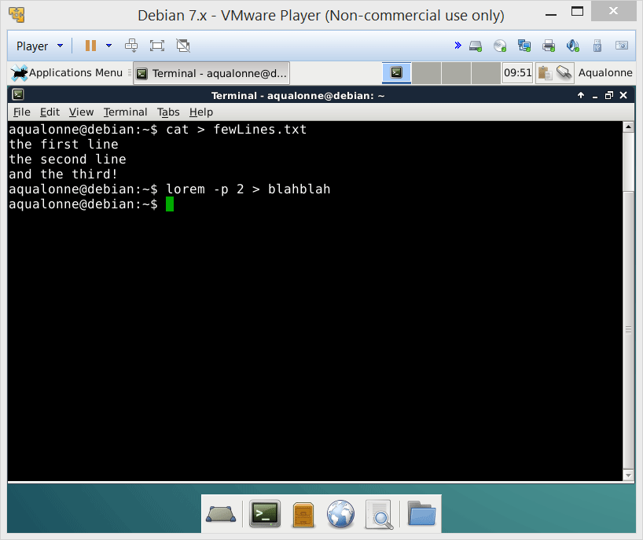
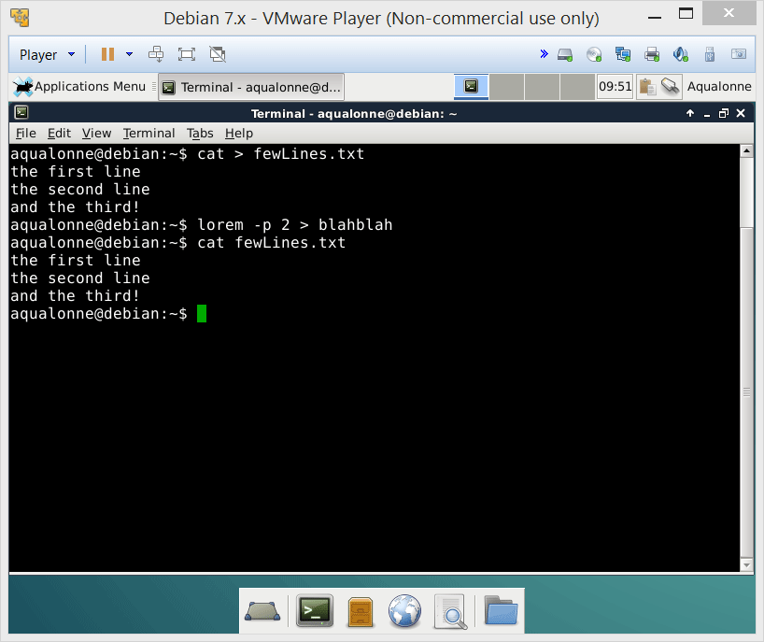
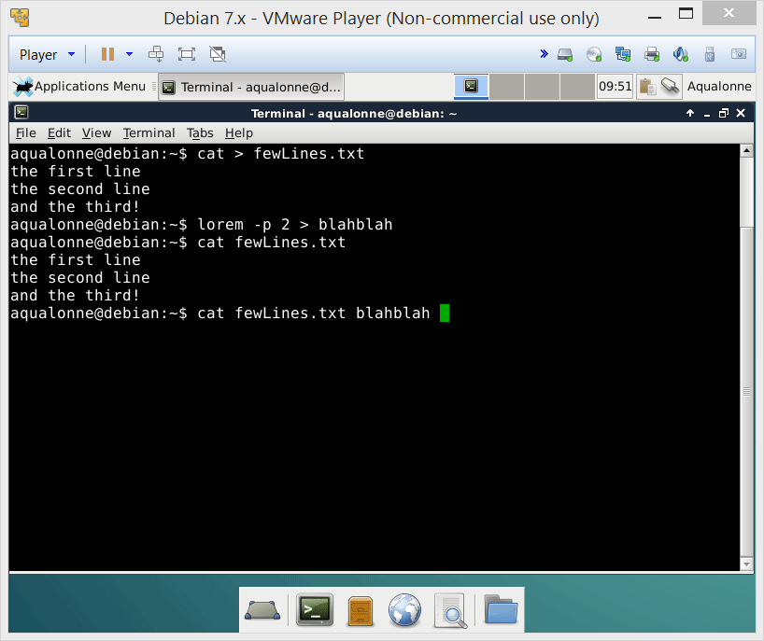
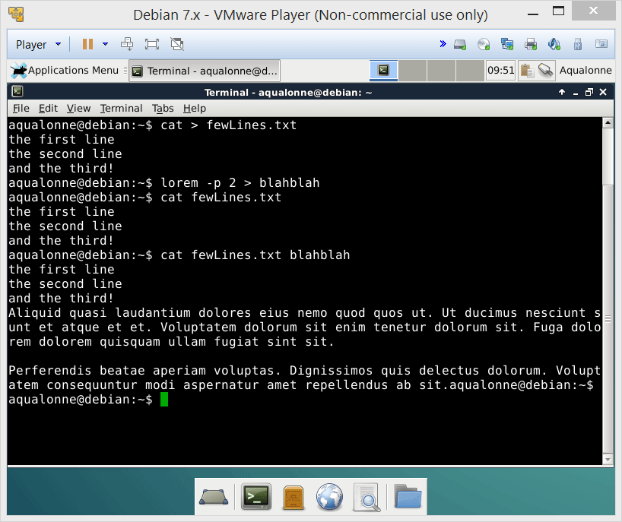
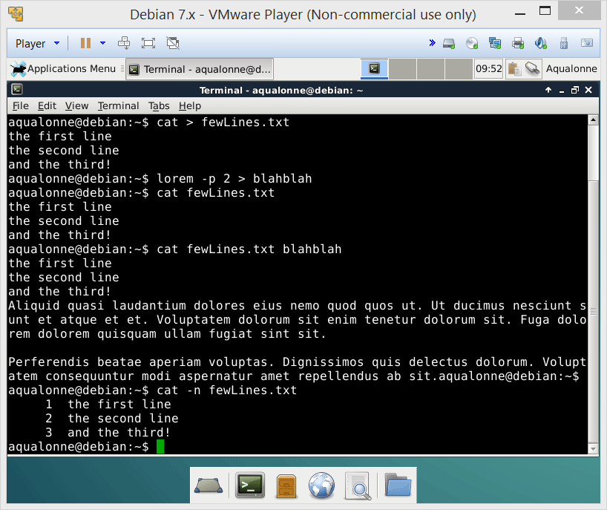
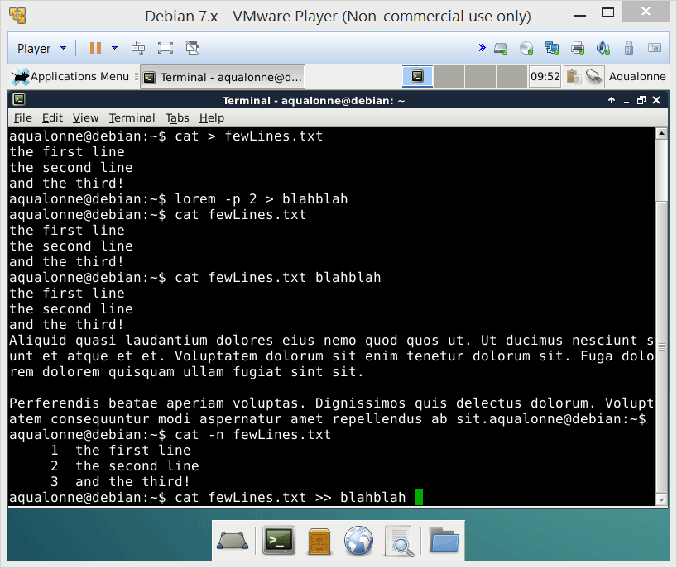
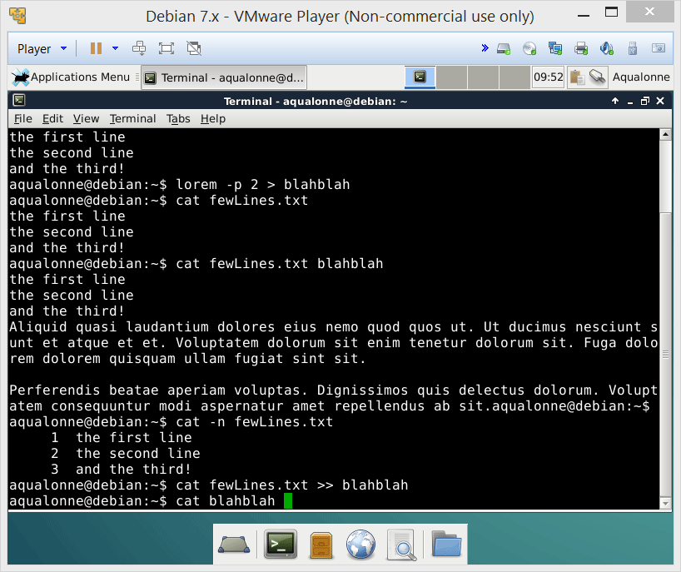
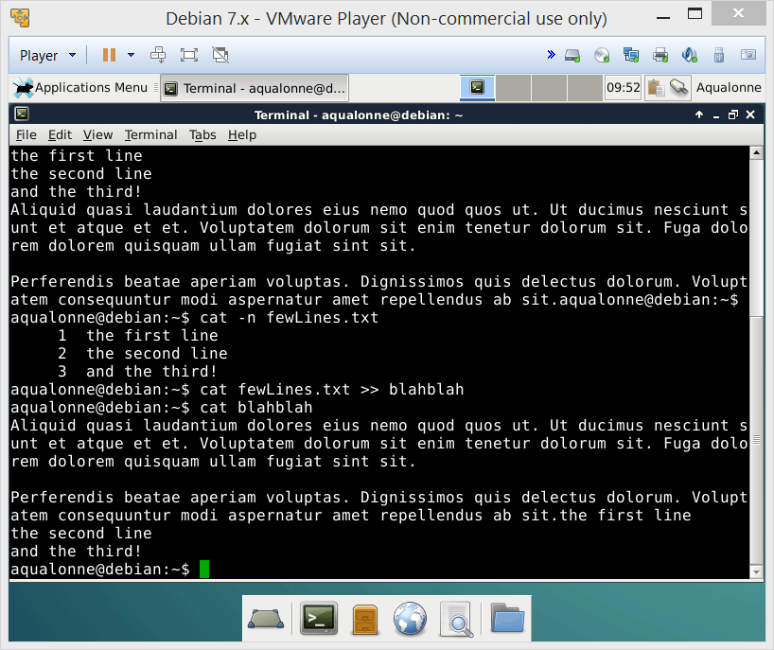

Display – cat
cat is a shortcut for concatenate
If you use it to create a file, stop via Ctrl + D
You can view 1 or more files. Because you can redirect what you see, you can thus glue files together.
13
File display, redirections and pipes

Slide 14


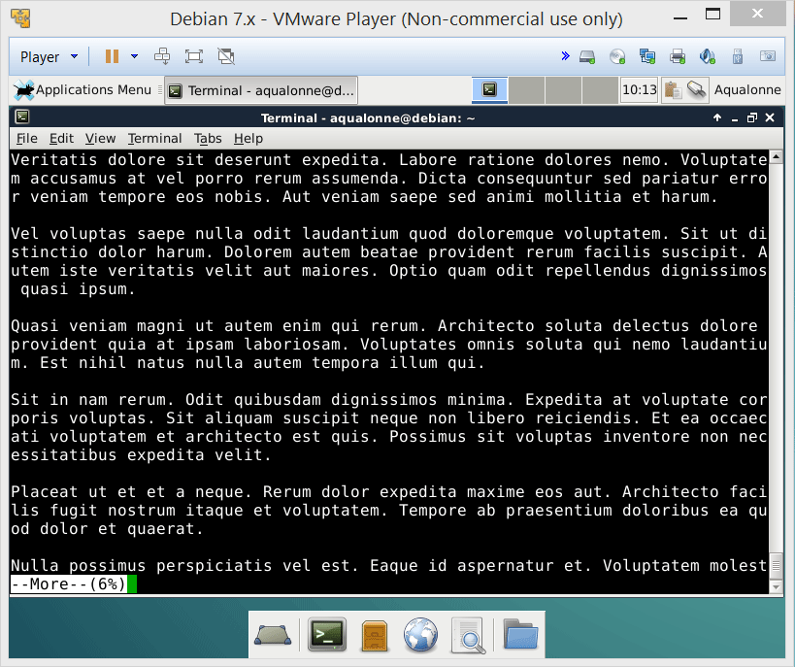
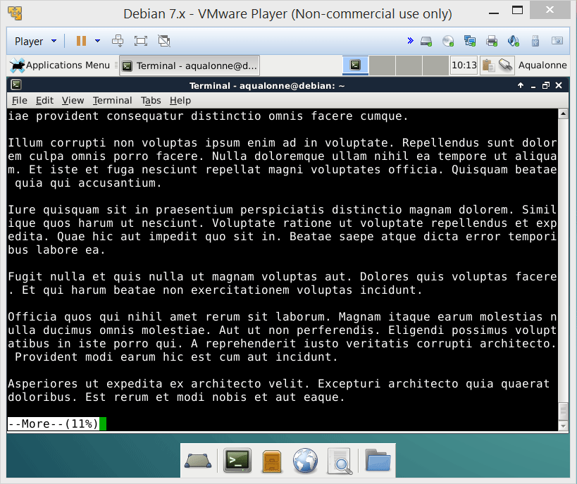
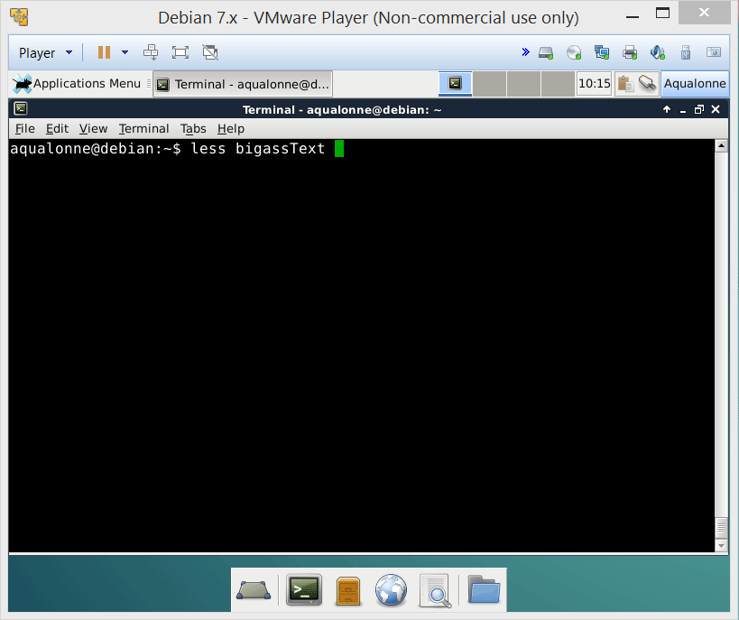
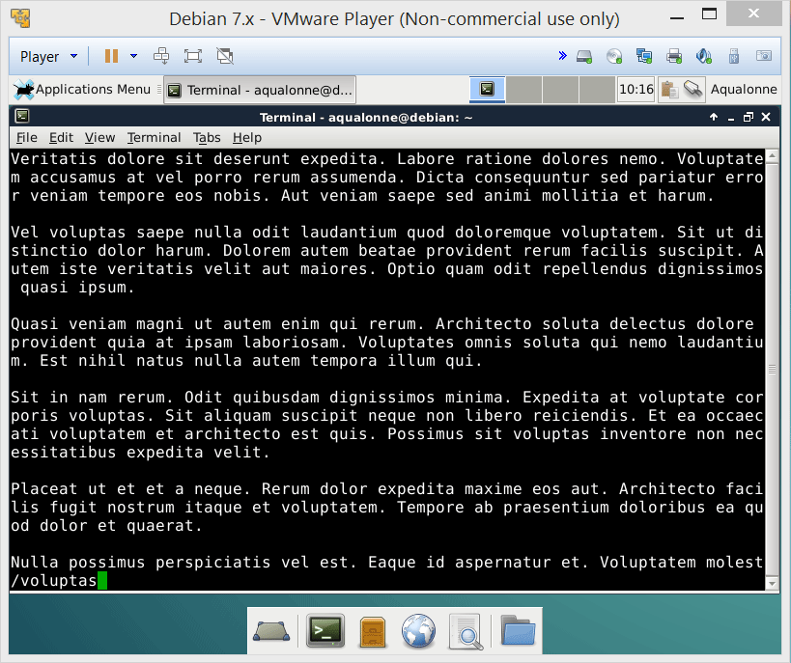
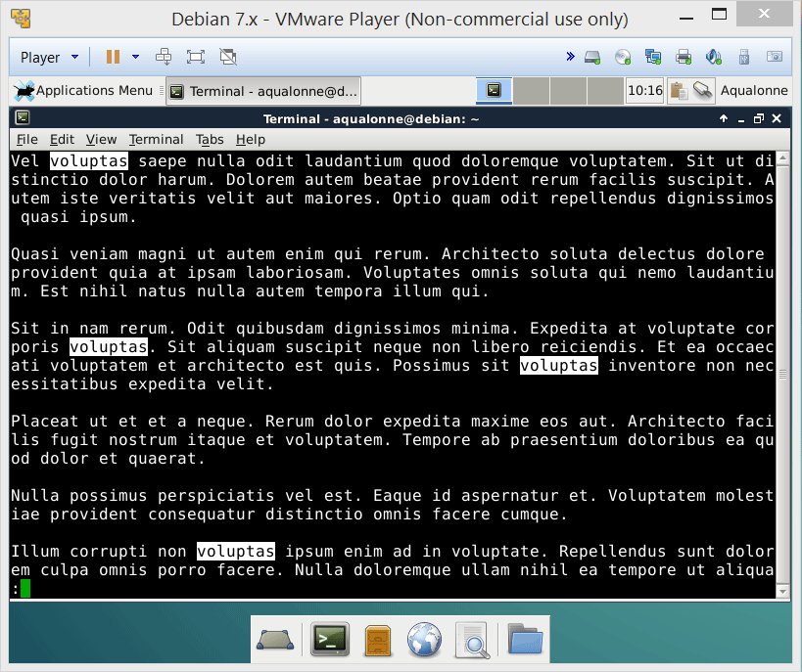
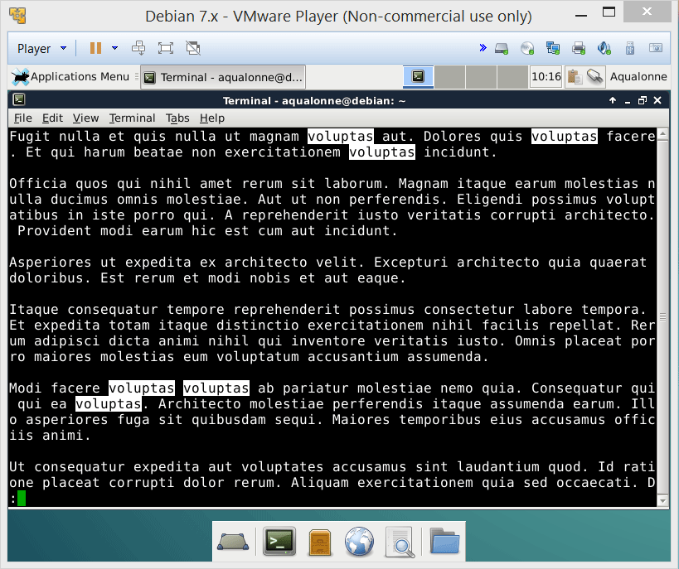
Display – big files
If you’re displaying a small file, cat is ok. If the files has several pages, you can try more, less or pg. Check the man entries for them.
q is how you stop them.
14
File display, redirections and pipes

Slide 15

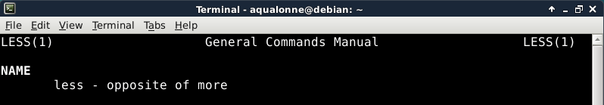

Display – big files
more is designed to go through text, one full screen at a time. It’s basic.
less can also go through text AND search, plus a lot of stuff... It’s more advanced.
(search using /
move in the search using n)
15
File display, redirections and pipes

Slide 16





Display – big files
See what less do what you use it on a PDF, DOC, JPEG or ZIP file!
16
File display, redirections and pipes

Slide 17
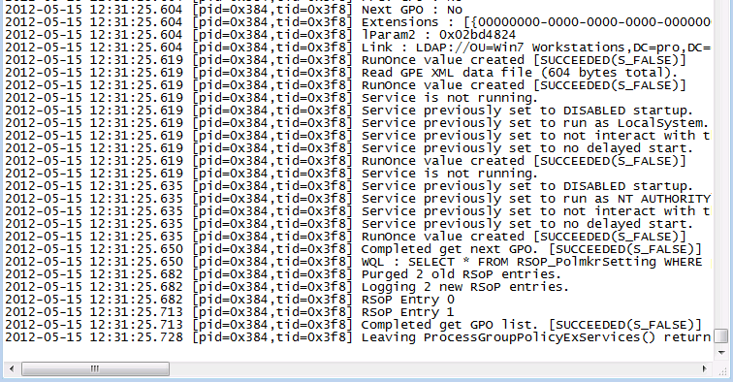

Display – big files
Going through large files using more/less can still be a little painful. Sometimes you just want the very end.
We usually just check the end of logs...
17
File display, redirections and pipes

Slide 18

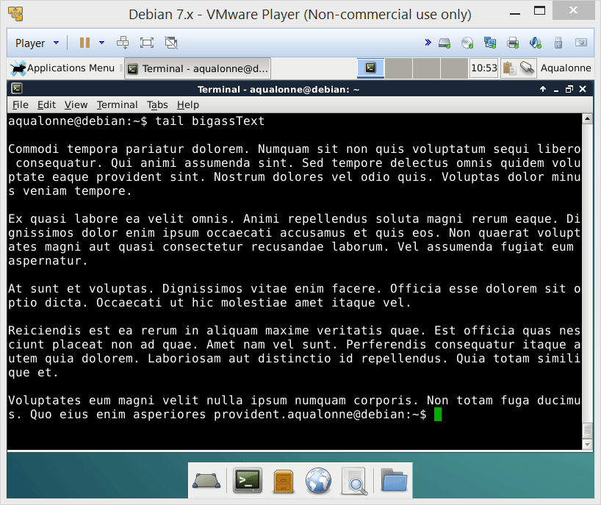
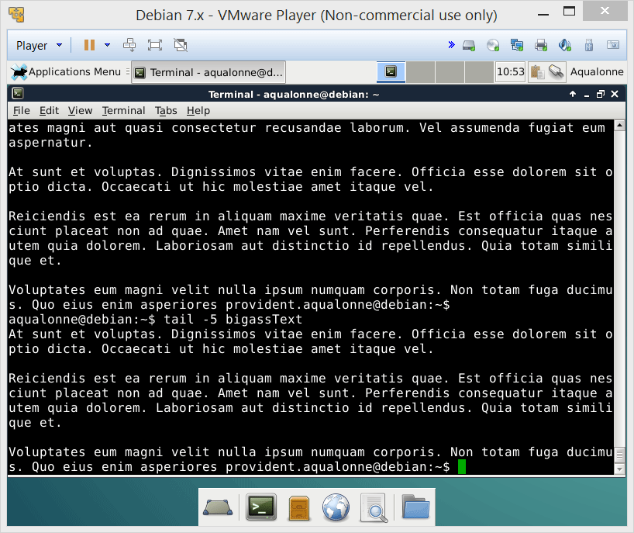
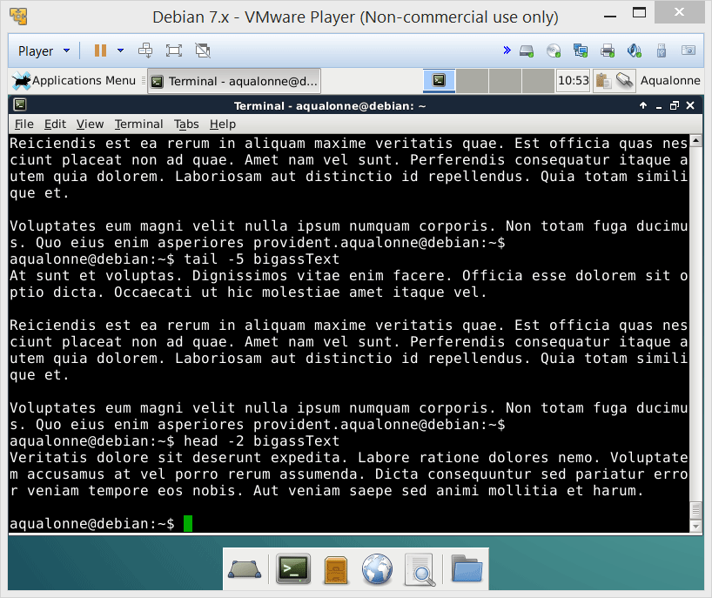
Display – big files
From the beginning
From the end
head and tail give you the -X lines you want
18
File display, redirections and pipes

Slide 19
Pipes - Principles
Program
Standard error
1
Standard output
Standard input
Program
2
19
File display, redirections and pipes

Slide 20


Pipes - Principles
Program 1
Program 2
Program 3
I/O
Redirections
Pipes
20
File display, redirections and pipes

Slide 21

Pipes - Principles
Sending data from one program to another is called a pipe.
The operator is |
21
File display, redirections and pipes

Slide 22


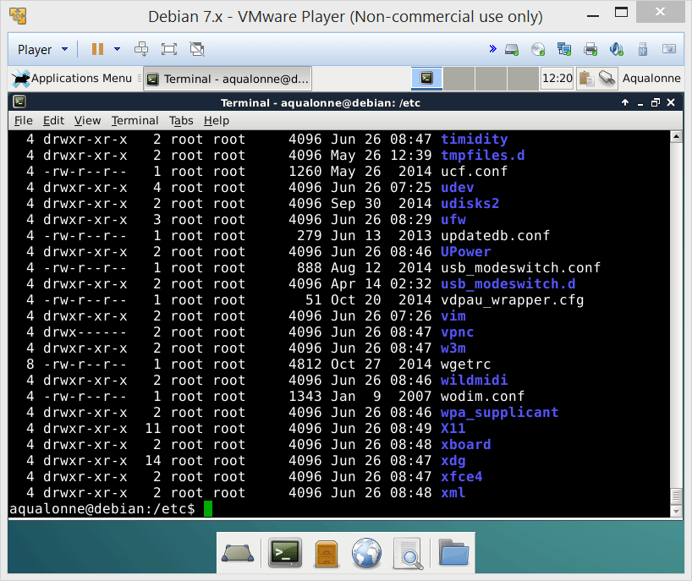
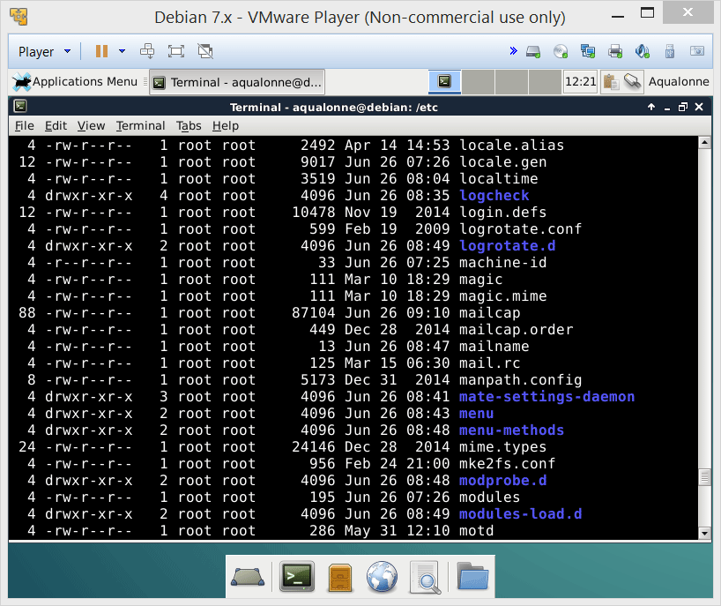
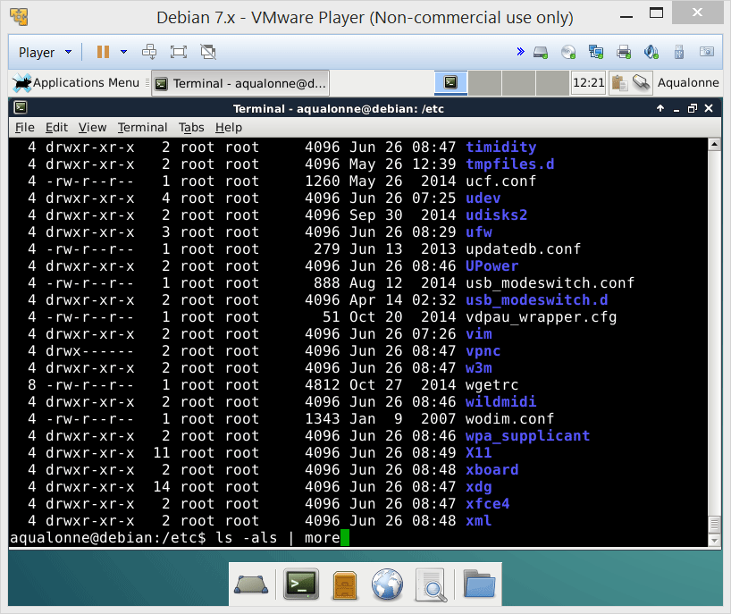
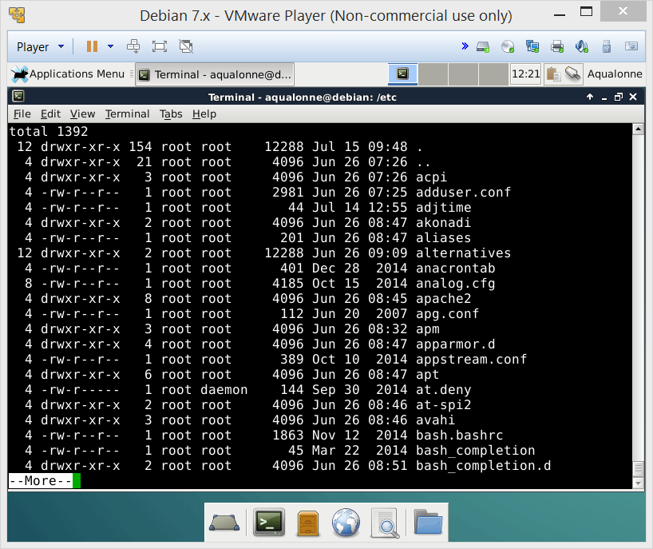
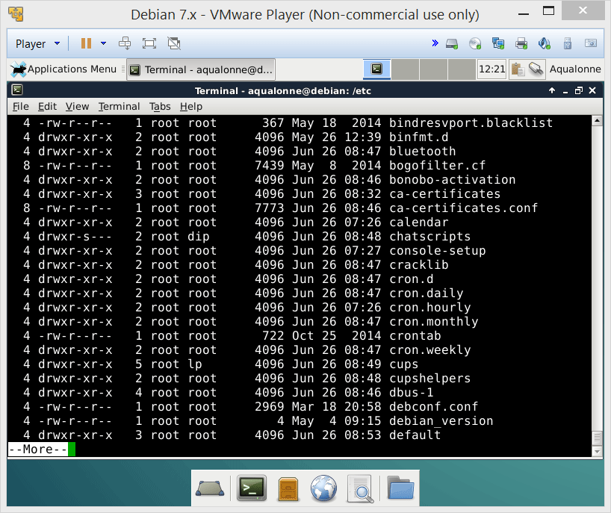








Pipes - Examples
22
File display, redirections and pipes

Slide 23

23
File display, redirections and pipes

Slide 24

Practice questions & activities
We recommend that you do these, but that’s for your own good, not graded.
Generate a large lorem text (10 paragraphs minimum). Then read the man page for less, and move through your text using less.
Call several commands that will produce errors, while redirecting the errors to a different file each time. Then, concatenate all these files (using cat) in one file named errorLog. Finally, show the first 10 (using tail) and the last 10 (using head) errors.
Redirect a large file as input to display commands such as more. What’s the difference with calling more and providing the file as argument?
Combine some of the commands you have learned using a pipe.
You have seen that there exists an IO/1 and IO/2 for standard output and standard error. Is there such thing as an IO/3 and, if so, what is it for?
24
File display, redirections and pipes

